Slide 1

ECE 5159-Class 5
DIGITAL SYSTEM DESIGN WITH VHDL
Engr. Professor Alice Oluwafunke Oke
Department of Computer Engineering, ACU, Oyo

Slide 2
USING SUBCIRCUITS
A VHDL entity defined in one source code file can be used as a subcircuit in another source code file.
In VHDL, subcircuit is called a component
A subcircuit must be declared using a component declaration
COMPONENT fulladd
PORT (Cin, x, y : IN STD_LOGIC;
s, Cout : OUT STD_LOGIC);
END COMPONENT ;

Slide 3
DECLARING A COMPONENT IN A PACKAGE
LIBRARY ieee ;
USE ieee.std_logic_1164.all ;
PACKAGE fulladd_package IS
COMPONENT fulladd
PORT (Cin, x, y : IN STD_LOGIC;
s, Cout : OUT STD_LOGIC); END COMPONENT ;
END fulladd_package ;

Slide 4
CONCURRENT ASSIGNMENT STATEMENTS
A Concurrent assignment statement is used to assign a value to a signal in an architecture body. E.g.
s <= x XOR y XOR Cin
VHDL provides four different types of concurrent assignment statements
Simple signal assignment
Selected signal assignment
Conditional signal assignment
Generate statements

Slide 5
CODE FOR A FULL ADDER
LIBRARY ieee ;
USE ieee.std_logic_1164.all ;
ENTITY fulladd IS
PORT (Cin, x, y : IN STD_LOGIC;
s, Cout : OUT STD_LOGIC); END fulladd ;
ARCHITECTURE Logicfunc OF fulladd IS
BEGIN
s <= x XOR y XOR Cin ;
Cout <= (x AND y) OR (x AND Cin) OR (y AND Cin);
END Logicfunc ;

Slide 6

EXAMPLE OF CONCURRENT ASSIGNMENT STATEMENTS
Simple Signal assignment
LIBRARY ieee ;
USE ieee.std_logic_1164.all ;
ENTITY fulladd IS
PORT (Cin, x, y : IN STD_LOGIC;
s, Cout : OUT STD_LOGIC);
END fulladd ;
ARCHITECTURE Logicfunc OF fulladd IS
BEGIN
s <= x XOR y XOR Cin;
Cout <= (x AND y) OR (x AND Cin) OR (y AND Cin);
END Logicfunc ;

Slide 7
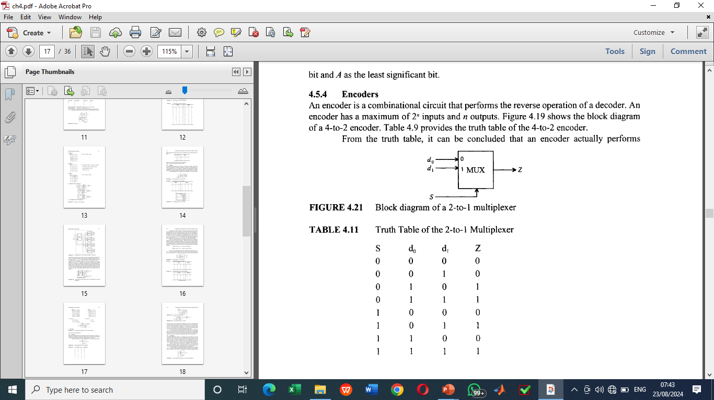
EXAMPLE OF CONCURRENT ASSIGNMENT STATEMENTS
Selected Signal assignment
Selected signal assignment allows a signal to be assigned one of several values based on a selection criterion.
Consider a multiplexer: a combinational circuit that selects one of n input lines and provides it on the output with the block diagram and Truth Table as shown

Slide 8

EXAMPLE OF CONCURRENT ASSIGNMENT STATEMENTS
The Selected Signal assignment for the multiplexer is as shown:
LIBRARY ieee ;
USE ieee.std_logic_1164.all ;
ENTITY mux2to1 IS
PORT (d₀, d₁, s : IN STD_LOGIC;
Z : OUT STD_LOGIC);
END mux2to1 ;
ARCHITECTURE Behaviour OF mux2to1 IS
BEGIN
WITH s SELECT
Z <= d₀ WHEN ‘0’;
d₁ WHEN OTHERS;
END Behaviour ;

Slide 9

EXAMPLE OF CONCURRENT ASSIGNMENT STATEMENTS
Conditional Signal assignment
Conditional signal assignment is similar to selected signal assignment. It allows a signal to be set to one of several values. An example using the mux2to1 is
LIBRARY ieee ;
USE ieee.std_logic_1164.all ;
ENTITY mux2to1 IS
PORT (d₀, d₁, s : IN STD_LOGIC;
Z : OUT STD_LOGIC);
END mux2to1 ;
ARCHITECTURE Behaviour OF mux2to1 IS
BEGIN
Z <= d₀ WHEN s = ‘0’ ELSE d₁ ;
END Behaviour ;

Slide 10
EXAMPLE OF CONCURRENT ASSIGNMENT STATEMENTS
Generate Statement
Generate statement is often used to describe regularly structured hierarchical code.
An example of such circuit is a 16-to-1 multiplexer using five instances of a 4-to-1 multiplexer subcircuit or a 4-bit ripple-carry adder using four instances of full adder.
This structure of a regular code for a 16-to-1 multiplexer can be written in a more compact form using a loop.
VHDL provides a feature called the FOR GENERATE statement for describing such regularly structured hierarchical code.

Slide 11
EXAMPLE OF N-RIPPLY ADDER CIRCUIT AND CODE
Consider this 3-input full adder
LIBRARY ieee ;
USE ieee.std_logic_1164.all ;
ENTITY fulladd IS
PORT (Cin, x, y : IN STD_LOGIC;
s, Cout : OUT STD_LOGIC); END fulladd ;
ARCHITECTURE Logicfunc OF fulladd IS
BEGIN
s <= x XOR y XOR Cin ;
Cout <= (x AND y) OR (x AND Cin) OR (y AND Cin);
END Logicfunc ;

Slide 12
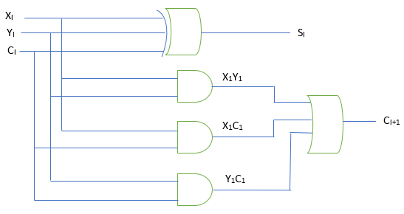
EXAMPLE OF N-BIT RIPPLE CARRY ADDER CIRCUIT
AND CODE
The circuit for the 3-input full adder
The Analysis
C_{I+1} = X₁Y₁ + C₁X₁ + Y₁C₁
= X₁Y₁ + C_{I} (X₁ + Y₁)
= g₁ + p₁c₁
Where g₁ = X₁Y₁, and p₁ = (X₁ + Y₁)

Slide 13
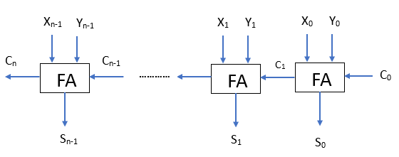
EXAMPLE OF N-BIT RIPPLE CARRY ADDER CIRCUIT
The symbol of an n-bit ripple-carry full adder is presented

Slide 14
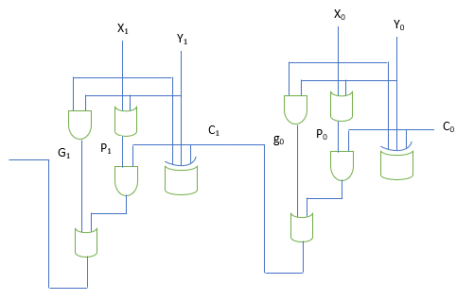
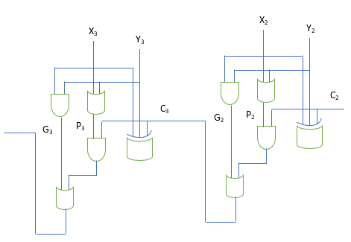
EXAMPLE OF N-BIT RIPPLE CARRY ADDER CIRCUIT
A 4-bit ripple-carry full adder

Slide 15
EXAMPLE OF N-BIT RIPPLE CARRY ADDER CODE
The VHDL code for a 4-bit ripple-carry full adder
LIBRARY ieee ;
USE ieee.std_logic_1164.all ;
ENTITY adder4 IS
PORT (Cin : IN STD_LOGIC;
x3, x2, x1, x0 : IN STD_LOGIC;
y3, y2, y1, y0 : IN STD_LOGIC;
s3, s2, s1, s0 : IN STD_LOGIC;
Cout : OUT STD_LOGIC);
END adder4 ;
ARCHITECTURE Structure OF adder4 IS
SIGNAL c1, c2, c3 : STD_LOGIC;
COMPONENT fulladd
PORT (Cin x, y : IN STD_LOGIC;
s, Cout : OUT STD_LOGIC);
END COMPONENT;
BEGIN
stage0: fulladd PORT MAP (Cin, x0, y0, s0, c1);

Slide 16
EXAMPLE OF N-BIT RIPPLE CARRY ADDER CODE Contd
stage1: fulladd PORT MAP (Cin, x1, y1, s1, c2);
stage2: fulladd PORT MAP (Cin, x2, y2, s2, c3);
stage3: fulladd PORT MAP (
Cin => c3, Cout => Cout, x => x3, y => y3, s => s3);
END Structure ;

Slide 17
SEQUENTIAL ASSIGNMENT STATEMENTS
Another type of assignment statement provided by VHDL is sequential assignment statements, the order of the statements in the code are executed sequentially. The order is significant in Sequential but not in Concurrent assignment statements.
The semantics of the code can be affected if done otherwise
The three variants of the sequential assignment statements are:
IF statement
CASE statement
Loop statement

Slide 18
PROCESS STATEMENT
The PROCESS statement is used to separate sequential statements from concurrent statements.
The PROCESS statement appears inside an architecture body and it encloses other statements within it.
The IF, CASE, and LOOP statements can appear only inside a PROCESS.
The general form of these statements are:

Slide 19
General Form of a PROCESS STATEMENT
[process_label;]
PROCESS [(signal name {, signal name} )]
[VARIABLE declarations]
BEGIN
[WAIT statement]
[Simple Signal Assignment Statements]
[Variable Assignment Statements]
[IF Statements]
[CASE Statements]
[LOOP Statements]
END PROCESS [process_label] ;

Slide 20
General Form of an IF STATEMENT
IF expression THEN
statement ;
{statement ;}
ELSIF
statement ;
{statement ;}
ELSE
statement ;
{statement ;}
ENDIF;
E.g.
IF Sel = ‘0’ THEN
F <= x1 ;
ELSE
F <= x2 ;
ENDIF;
SEL | X1 | X2 | F=MUL
0 | 0 | 0 | 0
0 | 0 | 1 | 0
1 | 1 | 0 | 0
1 | 1 | 1 | 1

Slide 21
EXAMPLE OF PROCESS STATEMENT USING IF-THEN-ELSE
PROCESS STATEMENT using if-then-else statement for 2-to-1 Multiplexer
LIBRARY ieee ;
USE ieee.std_logic_1164.all ;
ENTITY mux2to1 IS
PORT (d₀, d₁, s : IN STD_LOGIC;
Z : OUT STD_LOGIC);
END mux2to1 ;
ARCHITECTURE Behaviour OF mux2to1 IS
BEGIN
PROCESS (d₀, d₁, s )
BEGIN
IF s = ‘0’ THEN
Z <= d₀ ;
ELSE
Z <= d₁ ;
END IF ;
END PROCESS ;
END Behaviour ;

Slide 22
ALTERNATIVE CODE FOR IF-THEN-ELSE STATEMENT
LIBRARY ieee ;
USE ieee.std_logic_1164.all ;
ENTITY mux2to1 IS
PORT (d₀, d₁, s : IN STD_LOGIC;
Z : OUT STD_LOGIC);
END mux2to1 ;
ARCHITECTURE Behaviour OF mux2to1 IS
BEGIN
PROCESS (d₀, d₁, s )
BEGIN
Z <= d₀ ;
IF s = ‘1’ THEN
Z <= d₁ ;
END IF ;
END PROCESS ;
END Behaviour ;

Slide 23
PROCESS STATEMENT WITH CASE STATEMENT
CASE STATEMENT
A case statement is similar to selected signal assignment in that the case statement has a selection signal and includes WHEN clauses for various valuations of this selection signal
The general form of a CASE statement and the CASE STATEMENT for 2-to-1 Multiplexer are presented next

Slide 24
General Form of a CASE STATEMENT
CASE expression IS
WHEN constant_value =>
statement ;
{statement ;}
WHEN constant_value =>
statement ;
{statement ;}
WHEN OTHERS =>
statement ;
{statement ;}
END CASE ;

Slide 25
EXAMPLE OF PROCESS STATEMENT USING CASE STATEMENT
LIBRARY ieee ;
USE ieee.std_logic_1164.all ;
ENTITY mux2to1 IS
PORT (d₀, d₁, s : IN STD_LOGIC;
Z : OUT STD_LOGIC);
END mux2to1 ;
ARCHITECTURE Behaviour OF mux2to1 IS
BEGIN
PROCESS (d₀, d₁, s )
BEGIN
CASE s IS
WHEN ‘0’ =>
Z <= d₀ ;
WHEN OTHERS =>
Z <= d₁ ;
END CASE ;
END PROCESS ;
END Behaviour ;

Slide 26
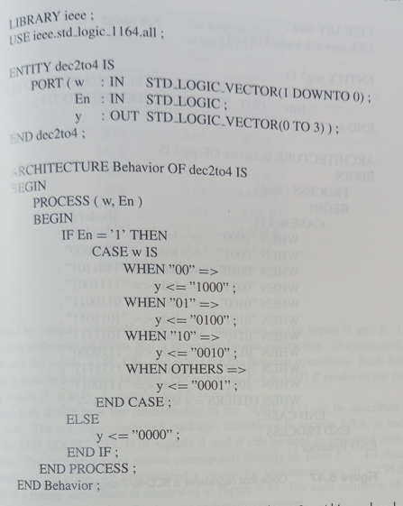
VHDL code that describes a process statement of a 2-to-4 binary decoder using a CASE statement

Slide 27
General Form of LOOP STATEMENTS
[loop_label;]
FOR variable_name IN range LOOP
statement ;
{statement ;}
END LOOP [loop_label] ;
[loop_label;]
WHILE boolean_expression LOOP
statement ;
{statement ;}
END LOOP [loop_label] ;

Slide 28
ASSIGNMENT
Write a VHDL code to represent the months of the year using a CASE statement

